Slide 1
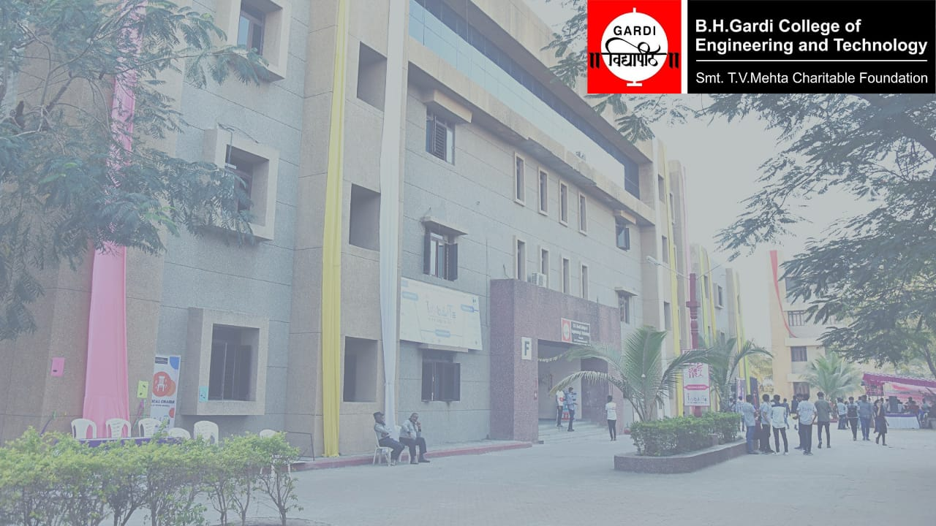
DEPARTMENT OF COMPUTER ENGINEERING
Presentation
on
Microsoft Elevate: Master Program on Azure/Copilot/PowerBI
Anjali Singh & anjali@fice.in
Presented by:
PARTH VADODARIYA 230043107015
Semester :- 8th
UNDER THE GUIDANCE OF:
HARSH MEHTA
Computer Department
BHGCET Rajkot

Slide 2
FICE Education Pvt. Ltd.
Company Address
FICE Education Pvt. Ltd. A-11-1105, Unitech Arcadia, South City-2, Gurugram – 122018, India
Company Brief Introduction
FICE Education Pvt. Ltd. is an education and training organization that provides industry-oriented skill development programs in collaboration with reputed technology partners such as Microsoft.
The company focuses on delivering online and virtual training programs in the domains of Data Analytics, Artificial Intelligence, Cloud Computing, and Business Intelligence.
FICE Education plays a vital role in bridging the gap between academic learning and industry requirements by offering structured internships, certification-oriented learning, and expert-led sessions.

Slide 3
Company Layout
OUTLINE OF PRESENTATION
As the internship was conducted in virtual mode, the company follows a digital operational structure.
Company Layout Includes:
Online training infrastructure
Learning Management Systems (LMS)
Virtual classrooms (Zoom)
Telegram & communication platforms
Digital assessment and certification systems
This virtual layout enables students across different locations to participate effectively.

Slide 4
Work Plan
12 week work plan
Week-wise Internship Work Plan
Week 1: Orientation & Introduction to AI and Data Analytics
Week 2: Data Handling, Data Cleaning, Data Visualization & EDA
Week 3: Power BI & Data Modeling, DAX
Week 4: Deep Learning & Artificial Neural Networks (ANN)
Week 5: Advanced DAX & Power BI Dashboard Development
Week 6: Machine Learning & Supervised Learning
Week 7: Unsupervised Learning & Reinforcement Learning
Week 8: Deep Learning & ANN (Advanced Concepts)
Week 9: CNN, TensorFlow & Keras
Week 10: Generative AI & Microsoft Copilot
Week 11: Cloud Computing Fundamentals & Azure Introduction
Week 12: Azure Experiments & Final AMA Session

Slide 5
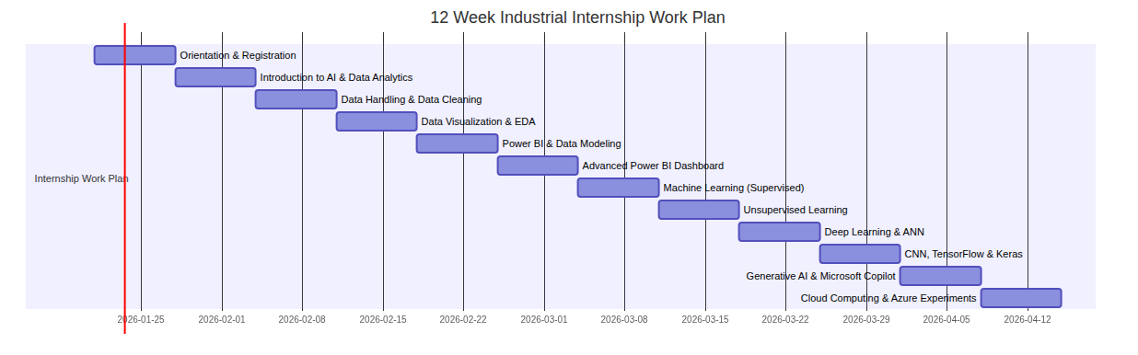
Work Plan
12 week work plan (Gantt Chart)

Slide 6
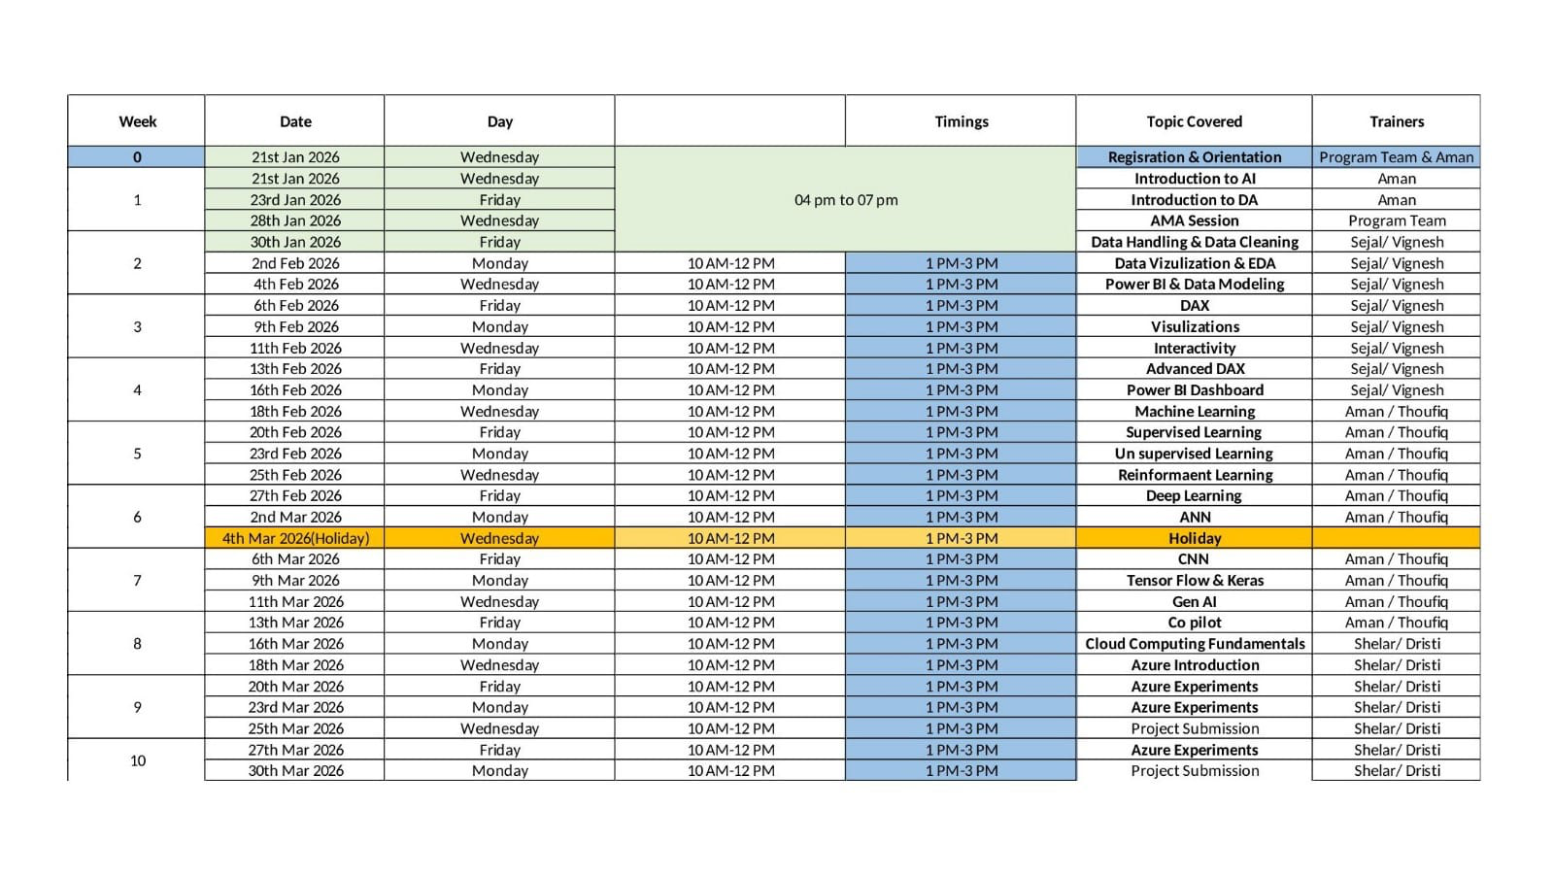
Work Plan Time Table
12 week work plan (Time Table)

Slide 7
Work Execution
What is work execution?
What is Work Execution?
Work execution refers to the practical implementation of planned activities during the internship period.
In this internship, work execution included:
Attending live online sessions
Understanding theoretical concepts
Observing demonstrations of tools and technologies
Performing guided practical exercises
Attempting assessments after each module
The execution was carried out in accordance with the internship schedule and guidelines.

Slide 8
List of Skill imparted
OUTLINE OF PRESENTATION
During the internship, the following skills were developed:
Technical Skills
Data Analytics fundamentals
Business Intelligence concepts
Power BI basics and dashboards
Artificial Intelligence & Machine Learning concepts
Cloud Computing fundamentals (Microsoft Azure)
Professional Skills
Analytical thinking
Problem-solving ability
Time management
Technical communication
Industry readiness

Slide 9
STRENGTHS DEVELOPED DURING TRAINING
OF PRESENTATION
Improved understanding of real-world technologies
Ability to analyze and interpret data
Exposure to industry-standard tools
Enhanced confidence in technical subjects
Better understanding of career opportunities in Data, AI & Cloud

Slide 10
POWER BI – FOR BUSINESS APPLICATIONS
This module focused on understanding Business Intelligence (BI) concepts using Microsoft Power BI. The training covered the complete process of transforming raw data into meaningful insights for business decision-making.
Key learning areas included:
Introduction to Business Intelligence and data analytics
Connecting Power BI to multiple data sources
Data cleaning and transformation using Power Query
Data modeling and relationship creation
Creating interactive reports and dashboards
This module enhanced the understanding of how organizations use data visualization to analyze business performance.

Slide 11
MICROSOFT AZURE
OF PRESENTATION
This module introduced cloud computing concepts using the Microsoft Azure platform. It provided a foundational understanding of cloud services and their role in modern IT infrastructure.
Topics covered:
Basics of cloud computing
Azure global infrastructure
Cloud service models (IaaS, PaaS, SaaS)
Azure subscriptions and resource groups
Introduction to virtual machines and storage
This module helped in understanding how cloud platforms support scalability, security, and cost-effective computing.

Slide 12
CLOUD ADMINISTRATION & ENGINEERING
OF PRESENTATION
This module focused on the administration and management of cloud resources. It emphasized the operational aspects of maintaining cloud environments.
Key concepts included:
Cloud resource management
Virtual networking and access control
Identity and access management
Monitoring and performance management
Backup and disaster recovery concepts
The module provided insight into how cloud administrators ensure reliability, security, and efficiency of cloud systems.

Slide 13
ARTIFICIAL INTELLIGENCE & MACHINE LEARNING
OF PRESENTATION
This module introduced Artificial Intelligence (AI) and Machine Learning (ML) fundamentals and their real-world applications.
Topics covered:
Introduction to Artificial Intelligence
Machine Learning concepts
Supervised and Unsupervised learning
Deep Learning and Artificial Neural Networks (ANN)
Applications of AI in healthcare, finance, and education
This module helped in understanding how intelligent systems learn from data and make predictions or decisions.

Slide 14
MICROSOFT COPILOT & GENERATIVE AI
OF PRESENTATION
This module focused on Generative AI and the use of Microsoft Copilot as an AI-powered productivity assistant.
Key learning areas included:
Introduction to Generative AI
Role of AI in automation and productivity
Microsoft Copilot features and applications
Ethical considerations in AI usage
AI-assisted content creation and data summarization
This module demonstrated how AI tools can enhance efficiency and decision-making in professional environments.

Slide 15
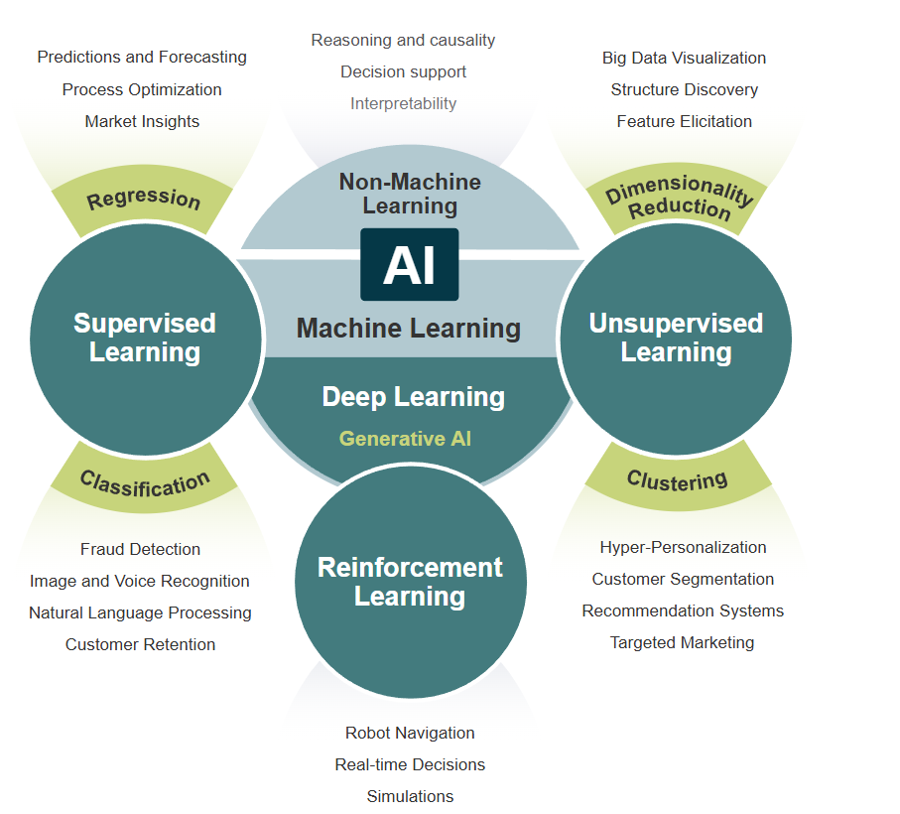
Week 1 — Introduction to AI & Data Analysis
OF PRESENTATION
​Work Done​
Learned fundamentals of Artificial Intelligence.​
Introduction to Data Analytics lifecycle.​
Understanding structured and unstructured data.​
Overview of Business Intelligence tools.​
Installation and setup of Power BI Desktop.​
Basic dataset loading and visualization creation.​
Concepts Learned​
AI vs Machine Learning​
Role of data in decision-making​
Data-driven organizations​
Types of analytics:​
Descriptive​
Diagnostic​
Predictive​
Prescriptive​

Slide 16
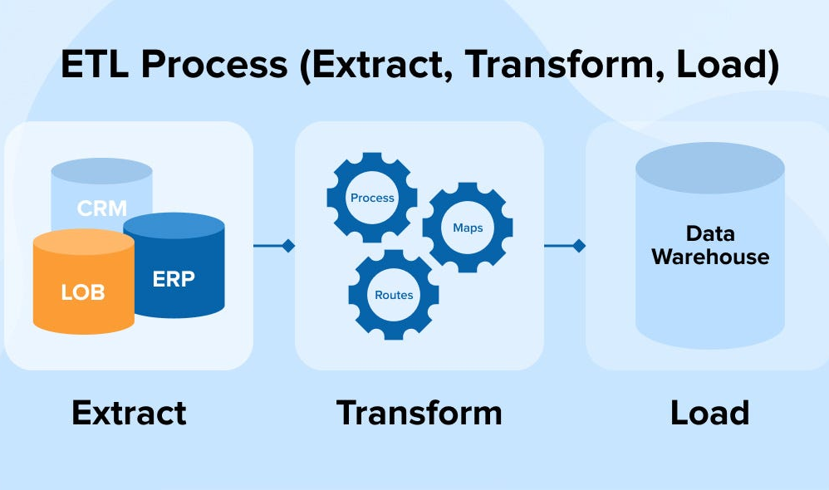
Week 2 — Advanced ETL Workflows & Data Transformation
OF PRESENTATION
Work Done
This week focused on ETL (Extract, Transform, Load) processes using Power Query Editor.
Connected datasets from Excel and CSV files.
Cleaned inconsistent datasets.
Removed duplicate records.
Handled missing values.
Changed column data types.
Performed Pivot and Unpivot operations.
Combined datasets using Merge & Append queries.
Performed Exploratory Data Analysis (EDA).
Skills Developed
Data cleaning techniques
Query transformation logic
Data profiling
Data normalization

Slide 17
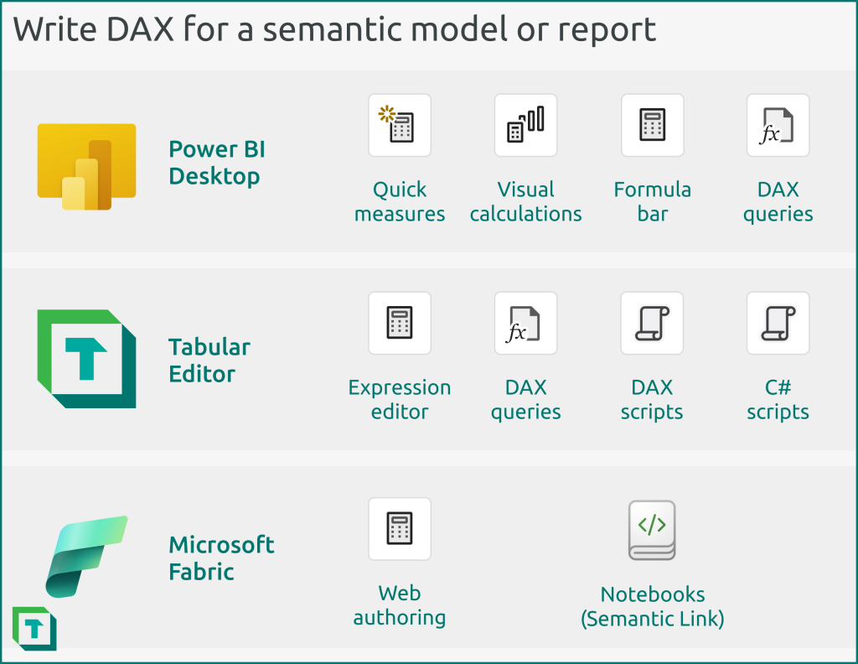
Week 3 — Semantic Modeling & DAX Development
OF PRESENTATION
Work Done
Focused on building efficient data models.
Learned Star Schema architecture.
Created Fact and Dimension tables.
Established relationships between tables.
Configured cardinality and filtering.
DAX Learning
Calculated Columns vs Measures
SUM(), AVERAGE(), COUNTROWS()
Filter Context & Row Context
Dashboard Interactivity
Added slicers for filtering.
Implemented bookmarks.
Created tooltips and navigation panels.

Slide 18
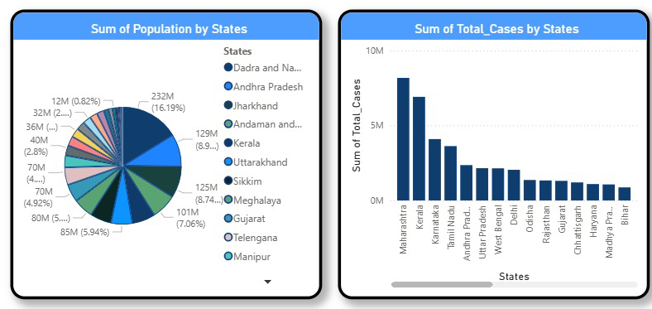
Week 4 — Business Intelligence Dashboards & Visualization
OF PRESENTATION
Work Done
Designed professional dashboards.
Dashboard Projects Created
📊 COVID-19 Analytics Dashboard
Active Cases KPI
Death Count Visualization
Discharged Patients Analysis
State-wise filtering
Population vs Cases comparison charts

Slide 19
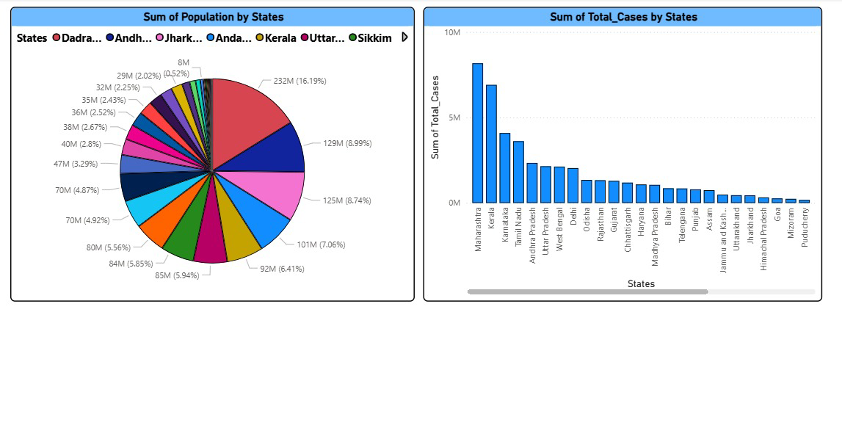
Week 4 — Business Intelligence Dashboards & Visualization
OF PRESENTATION
Work Done
Designed professional dashboards.
Dashboard Projects Created
📊 Population Analysis Dashboard
Pie chart for population distribution.
Bar charts comparing states.
Trend-based insights.

Slide 20
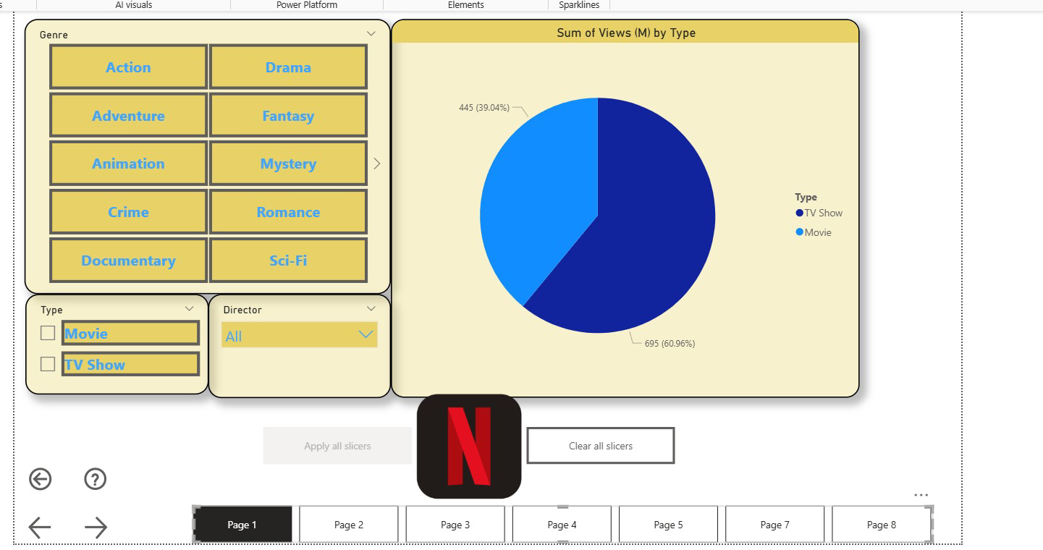
Week 4 — Business Intelligence Dashboards & Visualization
OF PRESENTATION
Work Done
Designed professional dashboards.
Dashboard Projects Created
📊 Entertainment Dataset Dashboard (Netflix Style)
Genre-based filtering.
Movie vs TV Show comparison.
Interactive slicers.
User-controlled dashboard navigation.

Slide 21
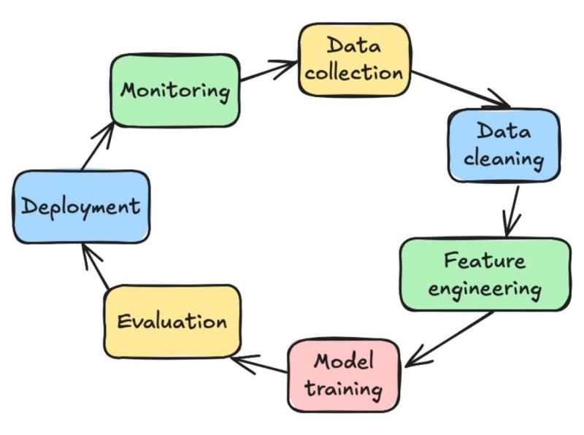
Week 5 — Machine Learning Fundamentals & Milestone Completion
OF PRESENTATION
Work Done
Transitioned from analytics to Machine Learning concepts.
Introduction to ML Pipeline.
Understanding supervised learning.
Dataset splitting:
Training Set
Validation Set
Testing Set
ML Concepts Covered
Regression (numeric prediction)
Classification (category prediction)
Model generalization
Feature scaling (theory)
Work Done
Transitioned from analytics to Machine Learning concepts.
Introduction to ML Pipeline.
Understanding supervised learning.
Dataset splitting:
Training Set
Validation Set
Testing Set
ML Concepts Covered
Regression (numeric prediction)
Classification (category prediction)
Model generalization
Feature scaling (theory)

Slide 22
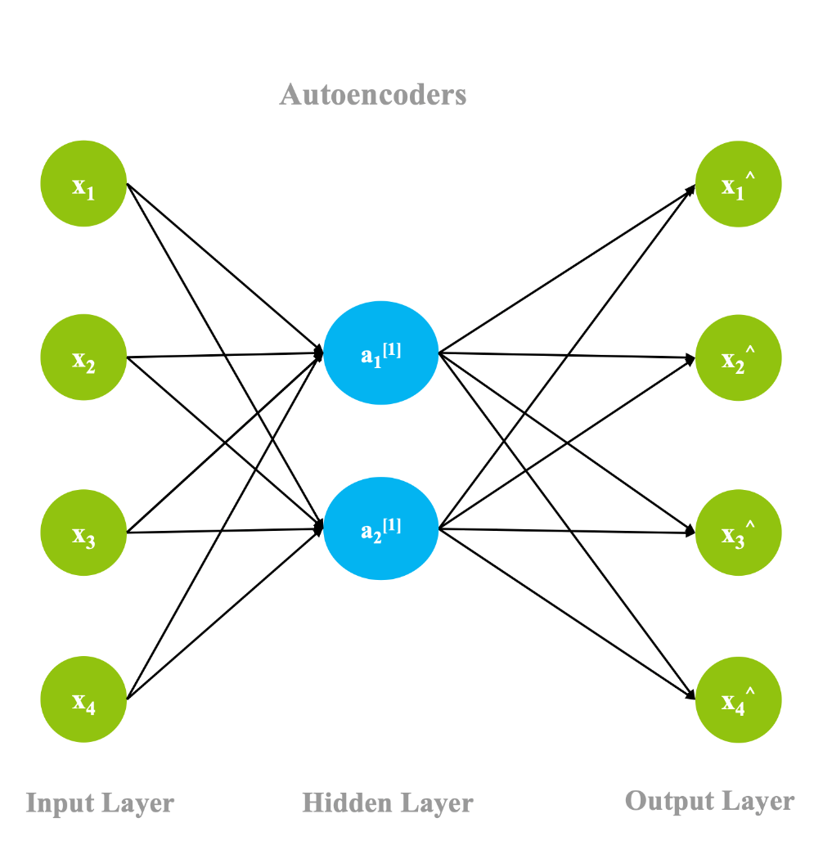
Week 6 — Deep Learning & ANN
OF PRESENTATION
Work Done
Deep Learning fundamentals.
Architecture of Artificial Neural Networks (ANN).
Identify patterns in complex data.
Analyzed real-world AI applications in healthcare, finance, and education.
Concepts Learned
Input, Hidden, and Output.
The role of weights, biases, and activation functions.
shallow learning and deep neural pipelines.

Slide 23
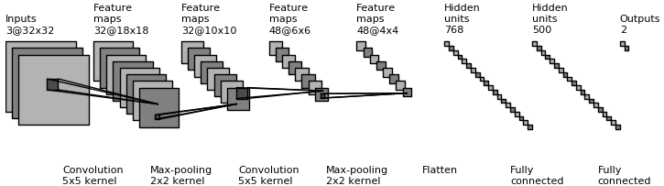
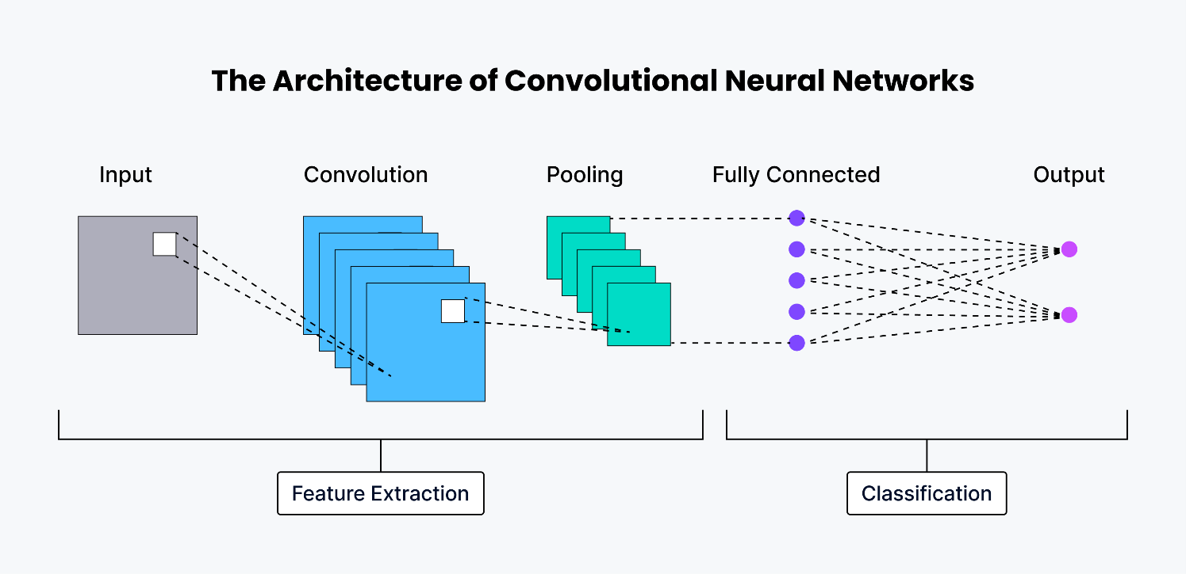
Week 7 — Computer Vision (CNN) & Generative AI
OF PRESENTATION
Work Done
data processing and generative systems.
Convolutional Neural Networks (CNN).
The role of Generative AI in modern automation.
vision-based architecture components:
Convolutional layers
Pooling layers
Padding techniques for data retention
Large Language Models (LLMs).
Concepts Learned
Computer vision fundamentals.
Ethical considerations in Generative AI usage.
AI-assisted content creation and data summarization.

Slide 24
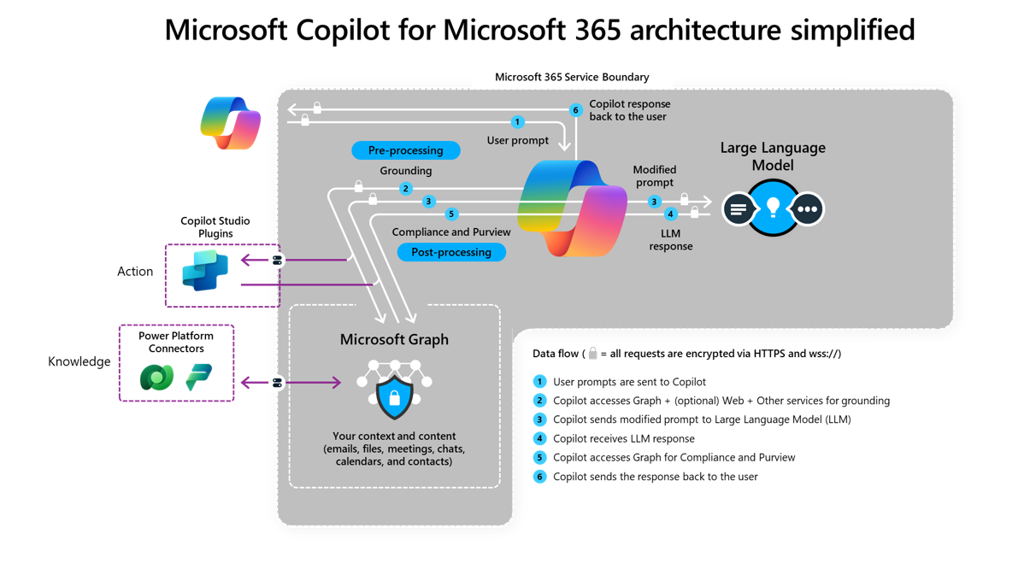
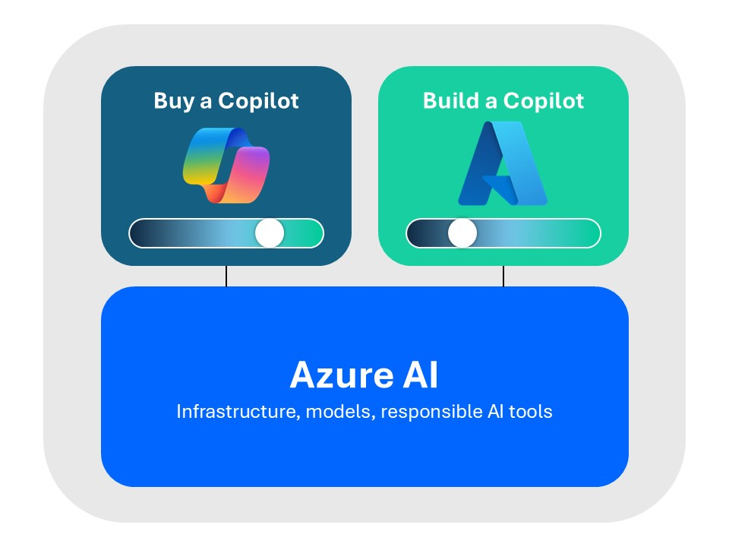
Week 8 — Microsoft Copilot & Cloud Fundamentals
OF PRESENTATION
Work Done
Transitioned to productivity tools and global cloud infrastructure.
Microsoft Copilot as an AI assistant.
Cloud computing and the Microsoft Azure.
Azure global infrastructure and data center concepts.
Cloud Service Models:
Infrastructure as a Service (IaaS)
Platform as a Service (PaaS)
Software as a Service (SaaS)
Concepts Learned
Roles of AI in professional automation and productivity.
Azure subscriptions and resource group organizations.
Benefits of cloud scalability, security, and cost-efficiency.

Slide 25
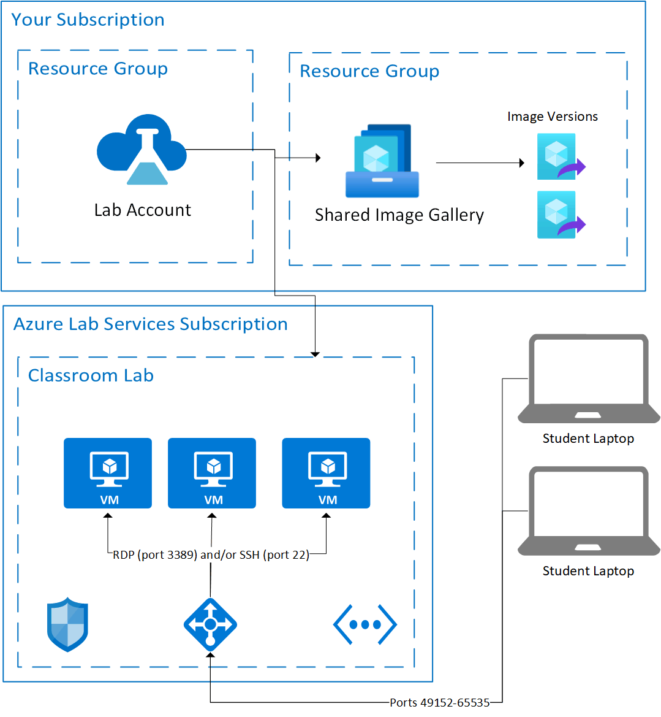
Week 9 — Azure Experiments & Administration
OF PRESENTATION
Work Done
Administration and management of cloud resources.
Practical labs for deploying and managing virtual machines (VMs).
Configured virtual networking and access control protocols.
Implemented identity and access management (IAM) strategies.
Administration Areas:
Cloud resource management
Performance monitoring
Resource security and auditing
Concepts Learned
Principles of secure and efficient cloud operations.
Virtual network isolation and connectivity management.
Strategies for cost-effective computing in the cloud.

Slide 26
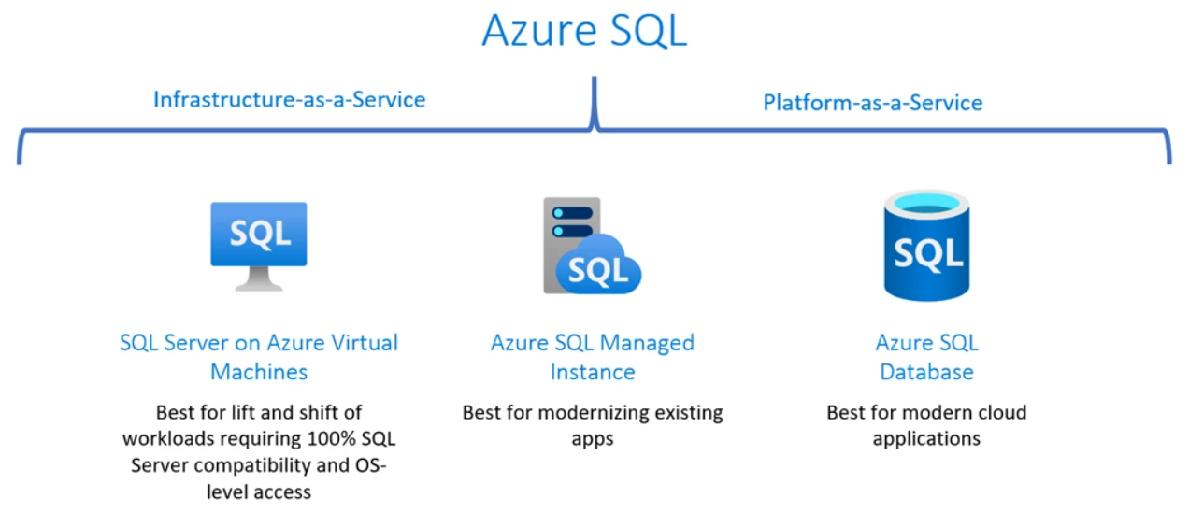
Week 10 — Advanced Operations & Milestone Completion
OF PRESENTATION
Work Done
Completed advanced technical labs and finalized program requirements.
Conducted advanced Azure experiments with SQL databases.
Explored backup and disaster recovery frameworks.
Project & Review Highlights:
Final technical skill verification
Review of industry readiness goals
Summarized learning outcomes across Data, AI, and Cloud modules.
Concepts Learned
Maintaining business continuity through cloud-based disaster recovery.
Real-world application of cloud and AI technologies.
Career opportunities in the modern Data and Cloud sectors.

Slide 27

Technical Skills Gained
OF PRESENTATION
During the internship, proficiency was developed in the following technical domains:
Data Analytics & BI: Mastery of ETL workflows, Power Query, and interactive Power BI dashboards.
Machine Learning: Practical understanding of Supervised, Unsupervised, and Deep Learning pipelines.
Deep Learning Frameworks: Hands-on experience with ANN, CNN, TensorFlow, and Keras.
Cloud Engineering: Expertise in Microsoft Azure administration, virtual networking, and resource management.
Generative AI: Advanced usage of Microsoft Copilot and prompt engineering for professional productivity.

Slide 28
Thanks

